Slide 1




Welcome to Code Crunch!
C8|Crunch Labs: Web Dev
THU 3-4PM Weekly | Spring 2025
Attendance
Earn a Certificate of Completion by attending at least 70% of the workshops
linktr.ee/CODE.CRUNCH

Slide 2
Week #8
Mastering Higher-Order Functions, Callback Functions, and Asynchronous Patterns

Slide 3
Introduction to the Week’s Topic
Overview: This week’s lecture focuses on advanced JavaScript concepts, particularly higher-order functions, callback functions, and asynchronous programming (Promises and async/await).
Real-World Relevance:
Higher-order functions enable more flexible and reusable code, allowing you to pass functions as arguments or return them from other functions.
Asynchronous programming is essential for handling tasks like network requests, ensuring that your application remains responsive while performing time-consuming operations.

Slide 4
Key Concepts for Today’s Lecture
Concepts Covered:
Higher-order Functions: Functions that accept other functions as arguments or return them as values.
Callback Functions: Functions passed into other functions as arguments that are invoked later.
Asynchronous JavaScript: Using Promises and async/await to handle operations that take time to complete, like HTTP requests.

Slide 5
Introduction to Higher-Order Functions
What is a Higher-Order Function?
A higher-order function is a function that takes one or more functions as arguments, returns a function, or both.
Example: The map method in JavaScript is a higher-order function because it takes a function as an argument and applies it to each element in an array.
Why Use Higher-Order Functions?
They enable code reuse and allow for more dynamic programming.
Higher-order functions are commonly used in functional programming paradigms.

Slide 6
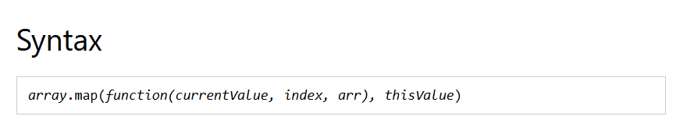
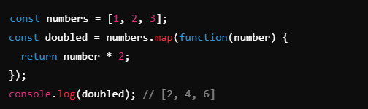

Slide 7
Common Examples of Higher-Order Functions

Slide 8

map(): Creates a new array with the results of calling a provided function on every element in the array.

Slide 9

filter(): Creates a new array with all elements that pass the test implemented by the provided function.

Slide 10
reduce(): Applies a function against an accumulator and each element in the array to reduce it to a single value.

Slide 11
Introduction to Callback Functions
What is a Callback Function?
A callback function is a function that is passed into another function as an argument and executed at a later time.
Why Use Callback Functions?
They allow for asynchronous behavior: Instead of blocking execution, callbacks are executed after certain operations are complete (e.g., network request, timer).
They are often used in event handling, animations, and server communication.

Slide 12
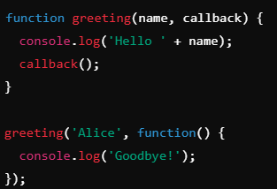

Slide 13
Problems with Callback Functions
Callback Hell (Pyramid of Doom): When you nest many callback functions, it can lead to difficult-to-read and hard-to-maintain
NEXT SLIDE Solution: This can be solved using Promises and async/await, which we’ll discuss shortly.

Slide 14
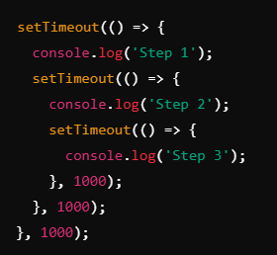
Solution: This can be solved using Promises and async/await, which we’ll discuss shortly.

Slide 15
Introduction to Asynchronous JavaScript
What is Asynchronous Programming?
Asynchronous programming allows your program to execute time-consuming tasks (like API calls, file reading) without blocking other operations.
Why is it Important?
It enables non-blocking behavior, which is crucial for building fast, responsive web applications.
Asynchronous tasks are often used for operations like retrieving data from a server, animations, or reading files.

Slide 16
Promises in JavaScript
What is a Promise?
A Promise is an object that represents the eventual completion or failure of an asynchronous operation.
Why Use Promises?
Promises provide a cleaner, more manageable way to handle asynchronous tasks compared to callbacks.
They help avoid callback hell and allow for better chaining of operations.

Slide 17
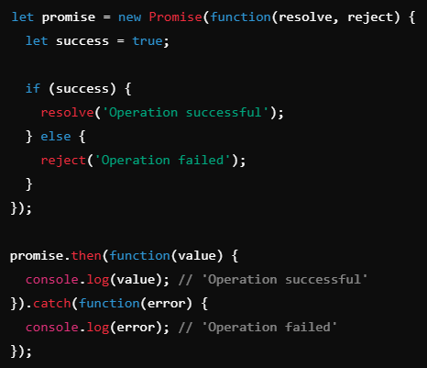

Slide 18
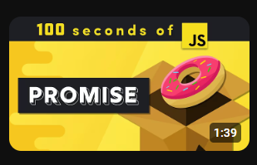
https://youtu.be/RvYYCGs45L4?si=wqhh2PhjznQmOYY6
Watch JavaScript Promises by FireShip
https://youtu.be/RvYYCGs45L4?si=wqhh2PhjznQmOYY6

Slide 19
Async/Await in JavaScript
Week 8: Advanced JavaScript Functions
Lecture:
Higher-order functions and callback functions.
Introduction to asynchronous JavaScript (Promises, async/await).
Coding Lab:
Refactor your code to use higher-order functions and async patterns for better interactivity.

Slide 20
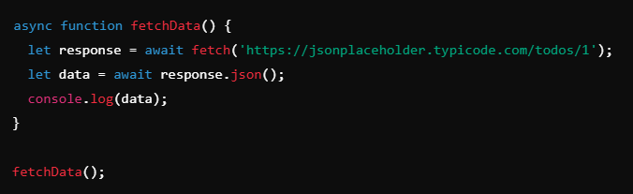

Slide 21
Best Practices for Using Async/Await
Always handle errors using try/catch to prevent unhandled promise rejections.
Keep asynchronous functions simple: Avoid long chains of asynchronous functions within the same function. Use separate helper functions if necessary.

Slide 22
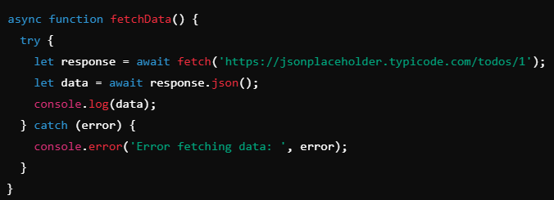

Slide 23
Real-World Example: Using Promises and Async/Await
Scenario: Fetching data from an API and displaying it on the page.
Using Promises or async/await allows us to handle the asynchronous request and handle the response cleanly without blocking the rest of the program.

Slide 24
Summary of Key Points
Higher-Order Functions: Functions that take other functions as arguments or return them.
Callback Functions: Functions passed as arguments and invoked at a later time.
Promises and async/await: Modern tools for handling asynchronous tasks without callback struggle.

Slide 25
Coding Lab

Slide 26
Introduction to the Coding Lab
Objective: In this lab, you will refactor your existing JavaScript code to implement higher-order functions and asynchronous patterns like Promises and async/await for better code organization and improved interactivity.
Skills Covered:
Refactor code to use higher-order functions for better reusability.
Implement asynchronous behavior with Promises and async/await.

Slide 27

Task 1 - Refactor Code to Use Higher-Order Functions
Objective: Refactor an existing loop or data processing function to use higher-order functions like map(), filter(), or reduce().
Example: Refactor a simple loop that filters even numbers using filter():

Slide 28
Task 2 - Refactor Code to Use Callback Functions
Objective: Refactor your code to handle asynchronous operations using callback functions. This could include functions like setTimeout, event listeners, or AJAX calls.

Slide 29
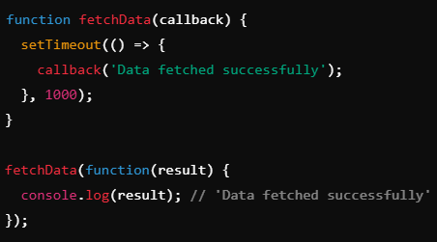
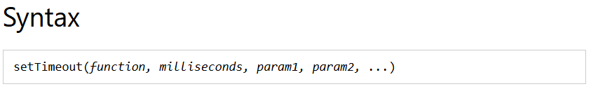

Slide 30
Task 3 - Implement Promises and Async/Await
Objective: Convert callback-based code into Promises or async/await to handle asynchronous operations.
Convert the example from Task 2 into a Promise:
Convert to async/await:

Slide 31
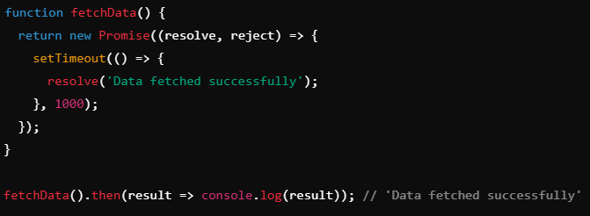
Convert the example from Task 2 into a Promise:

Slide 32
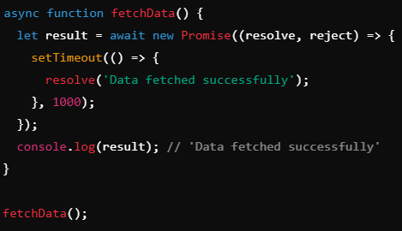
Convert to async/await

Slide 33
Q & A Session

Slide 34

https://github.com/CODE-CRUNCH-CLUB/C8-CRUNCH-LABS-WEB-DEV

Slide 35





Attendance
Join us for the next sessions
Check our schedule on Discord “Schedule” Channel
RSVP lu.ma/CODECRUNCH
Your feedback helps us improve. Share your thoughts! Go to our website: go.fiu.edu/codecrunch
linktr.ee/CODE.CRUNCH

